Slide 1
NIEM Training
September 28-30, 2021
Tom Carlson
GTRI / NIEM Consultant

Slide 2
PURPOSE
A technical webinar focused on developers and implementers who are interested in a deep-dive of the National Information Exchange Model.

Slide 3
IEPD Development
Overview
Process
Artifacts

Slide 4
Agenda
Mapping
Intro to Mapping
Mapping to Existing Objects
Creating New Objects
External Standards

Slide 5
Agenda
Creating and Validating Schemas
Assembly
Publishing
Implementation
Resources

Slide 6
Logistics
Three days, 1-4pm each day
Short breaks on the hour
Ask questions when you have them
Detailed outline and supporting materials at:
https://github.com/niem/niem-training

Slide 7
Introduction to NIEM
What is NIEM?
The Scope of NIEM
NIEM Harmonization and Organization

Slide 8
IEPD Process
Scenario Planning
Requirements Analysis
Mapping
Assembly
Publishing
(Implementation)

Slide 9
IEPD Artifacts
bullets

Slide 10
Requirements Analysis
Diagrams
Spreadsheets
Other documents

Slide 11
Potential Diagrams
bullets

Slide 12
UML Class Diagrams
The bread and butter of business requirements
Can be oriented towards business terms and objects
Better for consensus
Can be oriented towards NIEM terms and objects
Pre-loads the mapping step

Slide 13
Business Oriented Class Diagram
bullets

Slide 14
NIEM Oriented Class Diagram
bullets

Slide 15
UML Tools
ArgoUML
BOUML
Visio / OmniGraffle
Mermaid / Graphviz

Slide 16
Business Rules
Some rules aren’t easily represented in UML
You can use whatever works for your needs
Schematron for XML
Plain old textual descriptions are great!

Slide 17
The Process from Here On…
Step-by-step
Finish mapping entirely before starting schemas
Concurrent
Building schemas and instances as you go
We'll use something in-between
Build an ersatz matching instance document as we map
Save schema for the end

Slide 18
Introduction to Mapping
Mapping Spreadsheets Options
NIEM Mapping Template
Simple Training Spreadsheet
Something In-between
Document Business Objects
Map them to NIEM objects, existing or new
Maintaining an Ongoing Sample Instance Skeleton

Slide 19
NIEM Mapping Template
Primarily for submitting content for inclusion in NIEM
Eight different tabs
Can also be used for mapping in an IEPD
Just need one of the tabs
Is a bit overkill for an IEPD

Slide 20
Simple Training Spreadsheet
Minimal
Designed to be simple enough to fit on slides
No, really
Usually expanded in practice

Slide 21
Tom’s Custom Mapping Spreadsheet
Has evolved over time
Contains all the info needed to make schemas
Not as overwhelming as the NIEM Mapping Template
Works with in-progress secret tools

Slide 22
Basics of Searching NIEM
Tools
SSGT
Wayfarer
NIEM Schemas
Spreadsheet

Slide 23
Basics of Searching NIEM
Methods
Search for Terms
Simple vs Advanced
Search for Synonyms
Search for Word Roots
Search for Containers
Search for Properties

Slide 24
Mapping to Existing NIEM Objects
XML Schema uses elements and types
What an element can hold us based on its type
What you are (your type) defines what you can hold

Slide 25
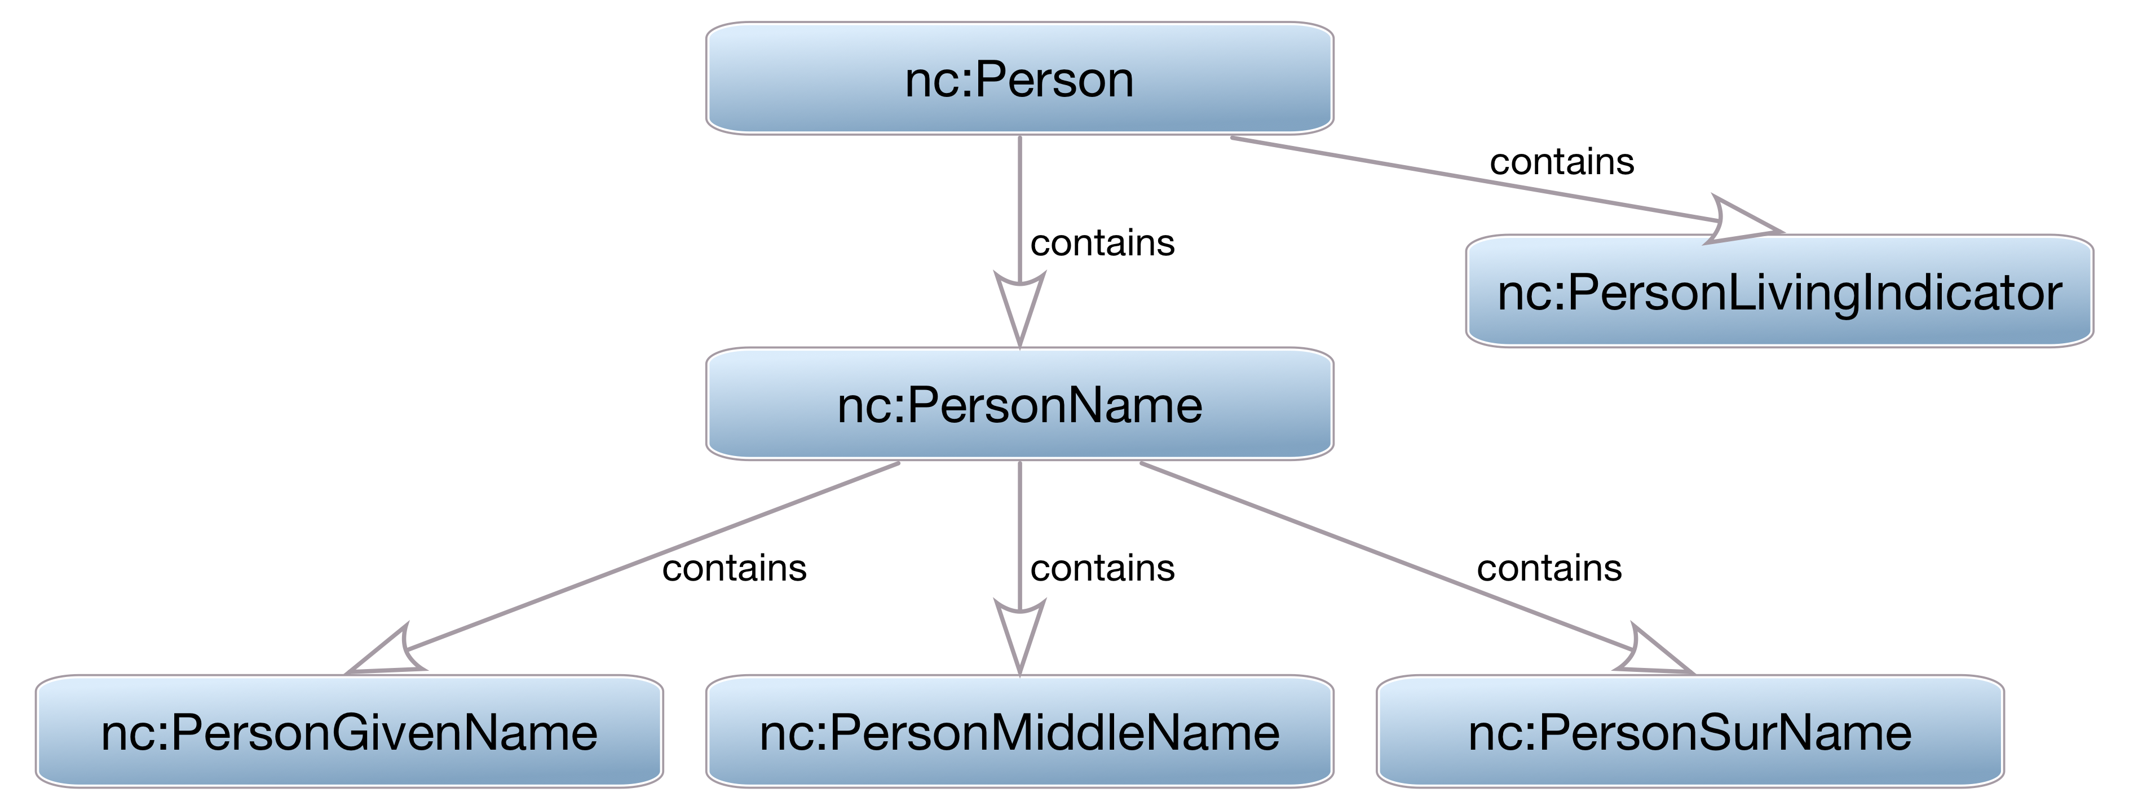
What you are defines what you hold

Slide 26
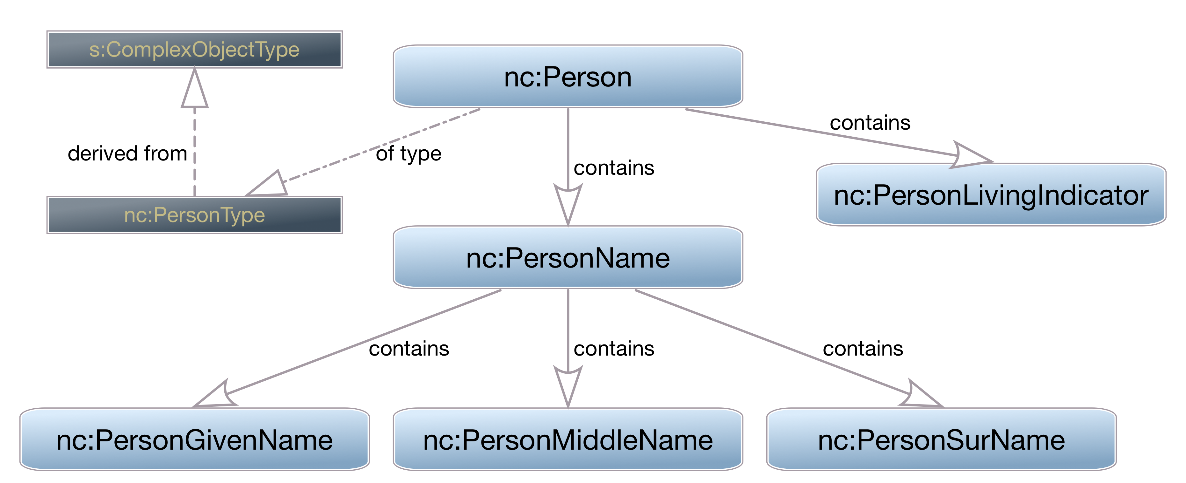
What you are defines what you hold

Slide 27
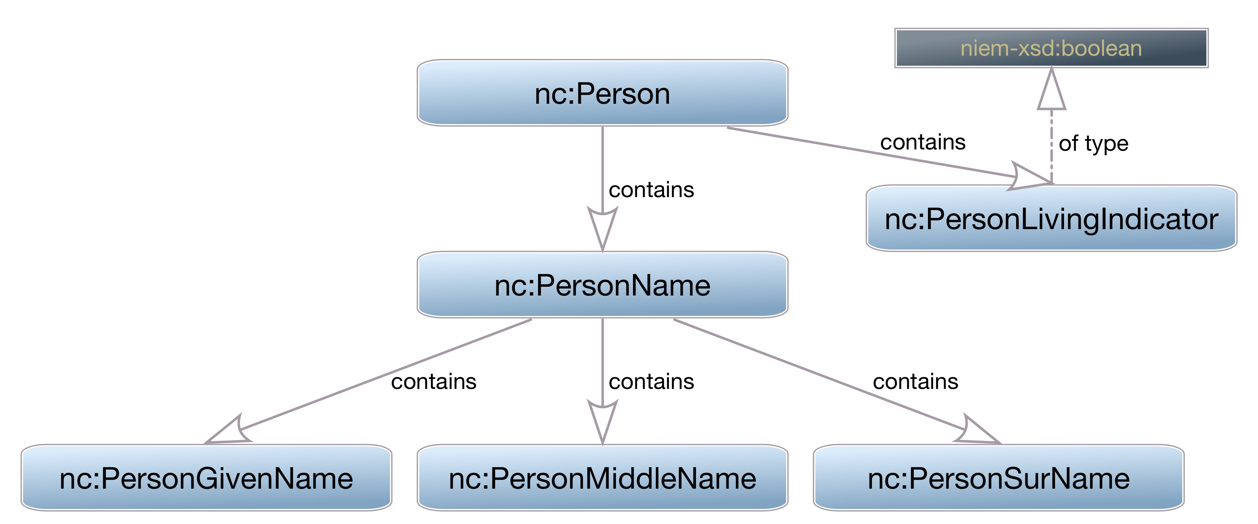
What you are defines what you hold

Slide 28
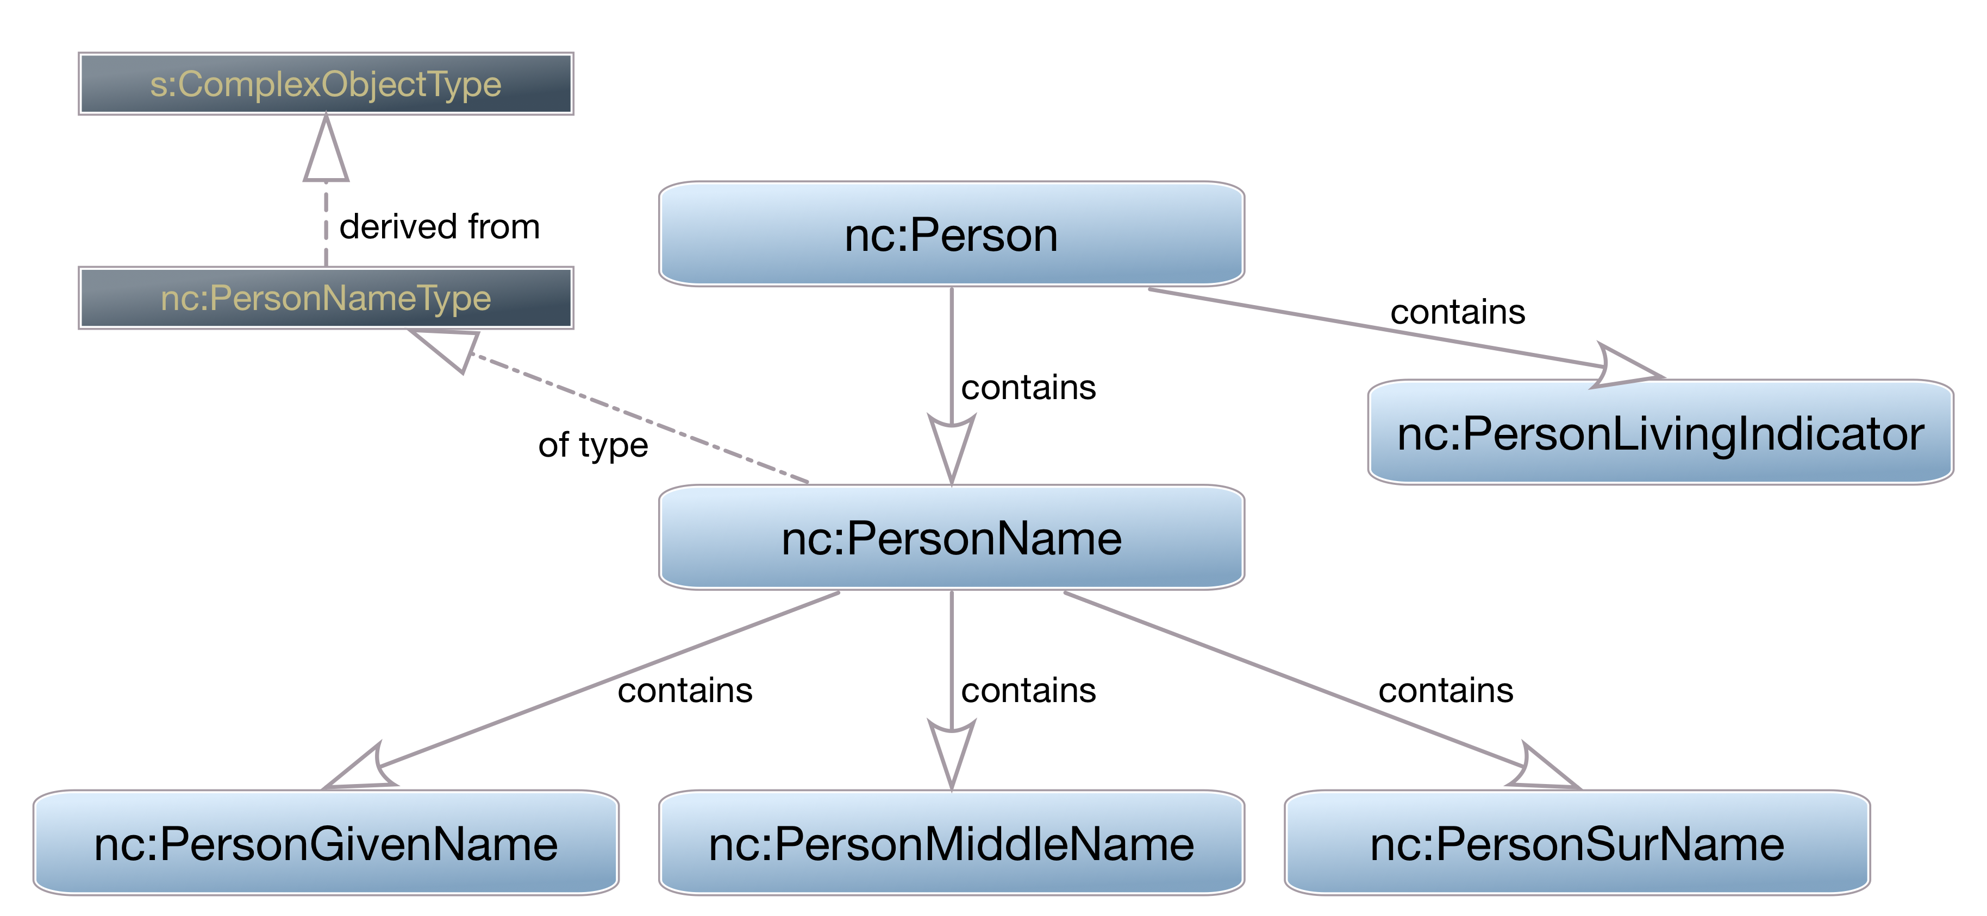
What you are defines what you hold

Slide 29
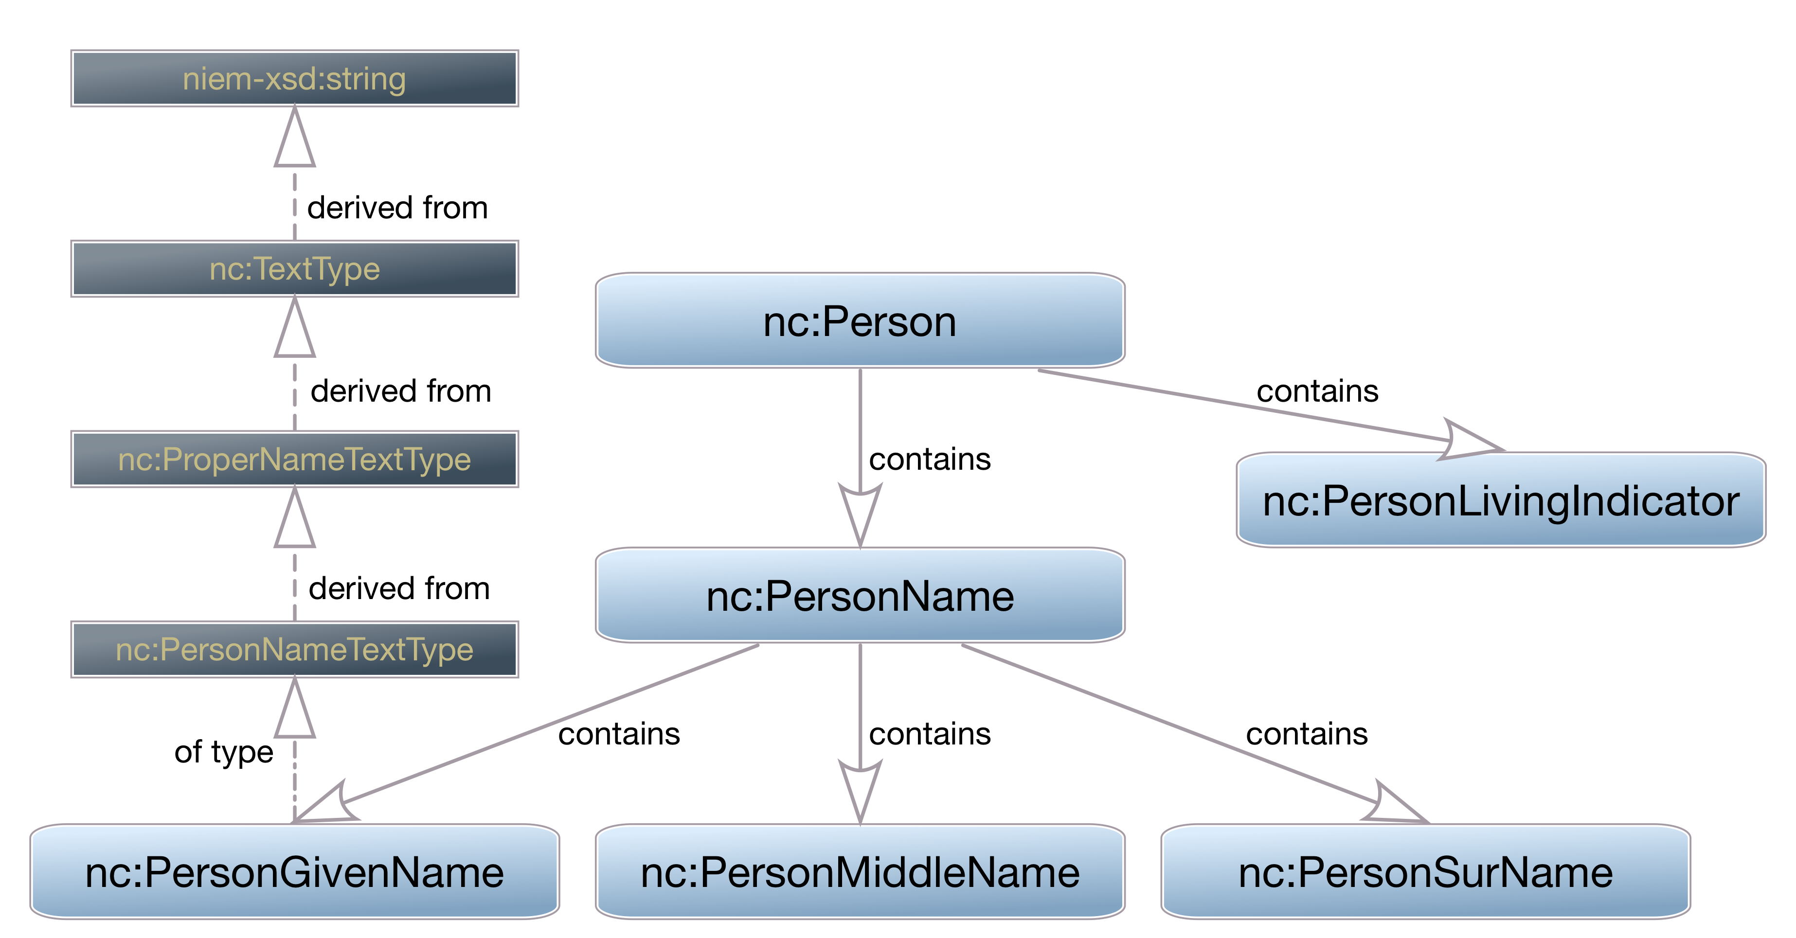
What you are defines what you hold

Slide 30
Native Properties
Some things will be easy to find
Will map directly to NIEM objects

Slide 31
Substitution Groups
Some concepts can be represented multiple ways
Text / code combinations are common
Date can be a date, datetime, or a range
NIEM uses substitution groups to support both:
The single concept, and
Multiple representations of that concept

Slide 32
Inherited Properties
NIEM is a model, not a flat data dictionary
Some concepts don’t exist as elements using the terms for the concept
Instead, properties are inherited
There is no “Crash Date” in NIEM
There is an Activity Date which can be inside a Crash object

Slide 33
Code Tables
Codes help ensure accurate information
Codes are, essentially, strings, simple data
NIEM wraps them in a complex type in order to apply some attributes needed for infrastructure
Which we will need in the next section…

Slide 34
Linking Things Together
NIEM is relational in many senses
Objects can refer to each other across an XML hierarchy
Allows NIEM to represent real world, many-to-many relationships
“structures” namespace provides the infrastructure

Slide 35
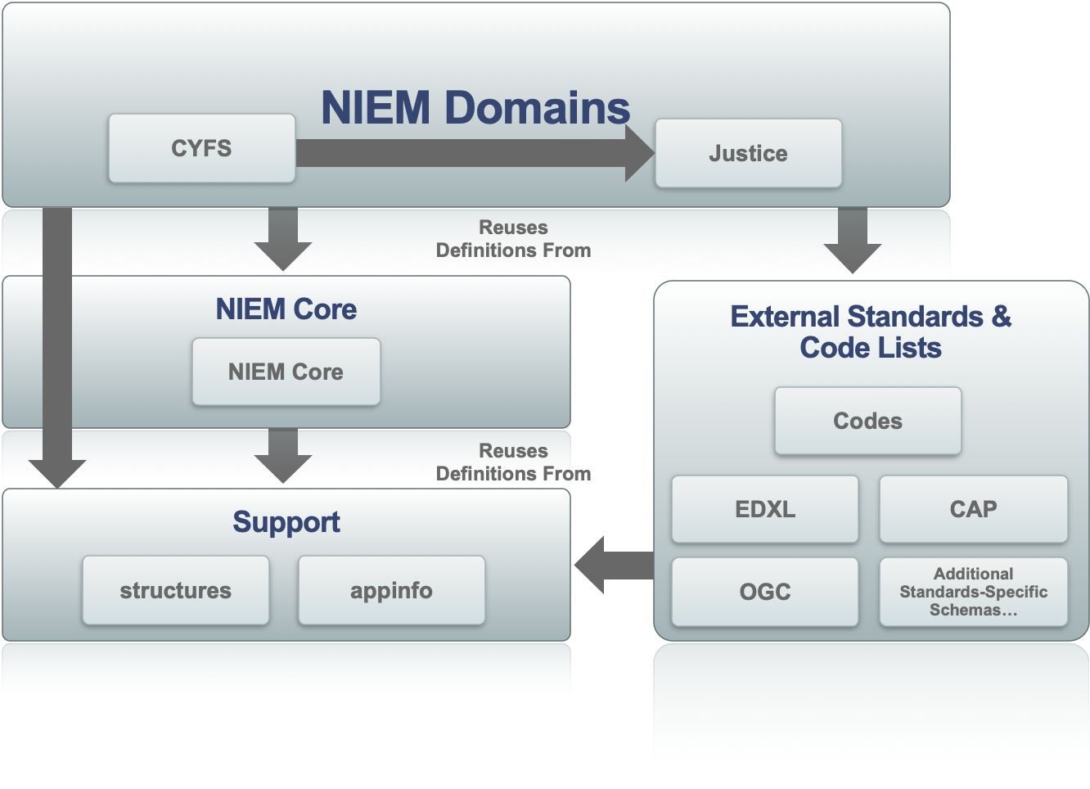
NIEM Structural “Layers”

Slide 36
Referencing
NIEM lets you assign unique IDs to object
Other objects can then link to those objects by referencing the ID
Everything in NIEM can have attributes for this:
id
ref
metadata
These leverage built-in XML Schema attributes ID, IDREF, and IDREFS

Slide 37
Associations
Associations link objects together
Associations reference the associated objects
Can link to multiple objects
Can thus form many-to-many relationships between them
Associations also hold information about the association itself
Date or Date Range is a common example
Associations can also just include them, if applicable

Slide 38
Roles
Modeling some objects as specialized things gets complicated
Roles are roles that objects play
Roles reference the objects playing the role
Objects can thus play multiple roles
Roles can also just include the object playing the role

Slide 39
Metadata
Metadata is data about data
Objects reference the metadata objects that apply to them
An objects can reference more than one metadata object
More than one object can reference the same metadata object

Slide 40

Data Metadata
Reporting Organization: Godspeed Animal Care
Reporting Person: Dr. Shiller
Reported Date: 2019-12-13
Last Verified Date: 2021-06-10
Name: Jett
Sex: Female
Weight: 8 pounds

Slide 41
Metadata
Easy to apply same metadata to many objects
Can result in messy many-to-many relationships
Powerful, but can be difficult to implement

Slide 42
Combining Domains
Sometimes you just want to add properties from other domains to an object without making a special kind of thing
Augmentations are bags of stuff
Augmentation Points are hooks onto which to hang the bags of stuff
Augmentations are an easy way to extend objects to meet your exchange needs

Slide 43
Title
bullets

Slide 44
Title
bullets

Slide 45
Title
bullets

Slide 46
Title
bullets

Slide 47
Resources - Tools
SSGT:
tools.niem.gov/niemtools/ssgt/index.iepd
MEP Builder (coming soon)
Wayfarer:
niem5.org
oXygen Snippets
niem.github.io/reference/tools/oxygen/snippets/
Mapping Spreadsheet Linter / Schema Generator

Slide 48
Resources - Documentation
NIEM Releases
NIEM Specifications

Slide 49
Why NIEM?
Your mission depends on sharing of data
Within and across your community
With Federal, State, Local, Tribal partners
With International partners
With Industry partners
Many LE stakeholders are using NIEM, to include but not limited to:
DOD, DHS, DOJ, International & INTERPOL, and State LE agencies
NIEM is also a key element of many of the Federal Government strategic imperatives
Notes:
So as I understand it, the missions of DHS are cross-cutting, with some being enterprise-wide, and not limited to just DHS. Whether you are investigating a human trafficking ring, securing our critical networks from cyber attacks, responding to a natural disaster, or adjudicating immigrants, NIEM provides a solution to solve data interoperability issues that cross these organizational, functional, and geographic boundaries.
When DHS was formed each Component, brought legacy systems and has continued to build new systems according to their specific business and operational needs without the vision of sharing data across various information domains such as health, fire, police, etc… As a consequence, data management and information sharing, is fragmented at best and we are increasingly realizing the value of using data from a multitude of sources to enable decision making and leverage emerging technologies such as AI.
At the heart of all of this is data.

Slide 50
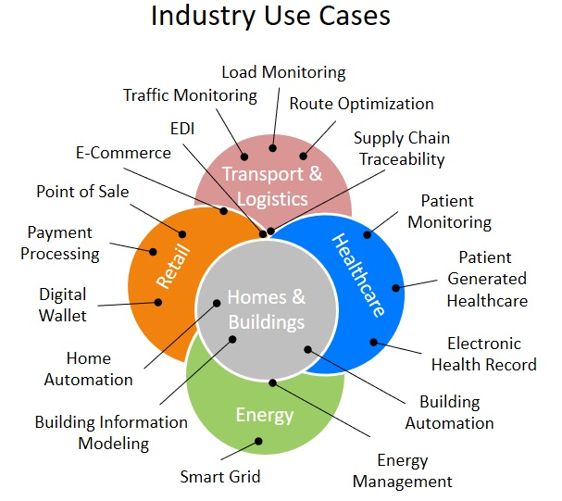
Interoperability
Across all levels of government, industries, and technical solution providers, interoperability is an essential tool for:
Better decision making
Reduction of manual processing
Increased productivity
Reduction of errors
Management of costs
Everyone agrees it takes interoperability of systems
to achieve these benefits.

Slide 51
Interoperability Challenges
If everyone agrees, why is there a ‘lack of interoperability’ problem?
Lack of unified agreement on standards selection and implementation
Siloed (domain-specific) development efforts driven by need, isolated by incompatibility
Proprietary and vendor-driven solutions vs. Interoperable driven solutions
Information Blocking - business, technical, and organizational practices that prevent or materially discourage access, exchange or use
Effective information sharing is critical to the missions

Slide 52
Interoperability Solution
The key factor to achieve interoperability is data
Information exchange is critical to ensuring timely information is available when and where it is needed
To exchange data, systems must have agreement on:
Syntactic: Data encodings and representation
Semantic: Consistent terminology and meanings
NIEM Solves the Interoperability Challenges at the Data Level

Slide 53





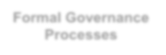

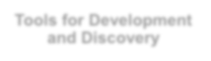

















NIEM Framework
NIEM is a community-driven, government and jurisdiction-wide, standards-based approach to exchanging information
Diverse communities can collectively leverage NIEM to increase efficiencies and improve decision-making
NIEM is available to everyone, including public and private organizations
NIEM includes a data model, governance, training, tools, technical support services, and an active community to assist users in adopting a standards-based approach to exchanging data
NIEM Community
Technical Framework
Support Framework
Formal Governance Processes
Data Model
Tools for Development and Discovery
Online Repositories
XML Design Rules
Established Training Program
Mission-Oriented Domains
Development Methodology
Implementation Support
Self-Managing Domain Stewards
Predefined Deliverables (IEPD)
Help Desk & Knowledge Center
53

Slide 54
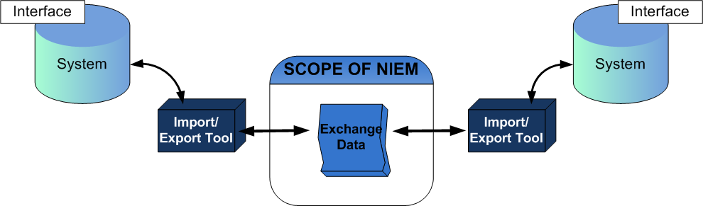
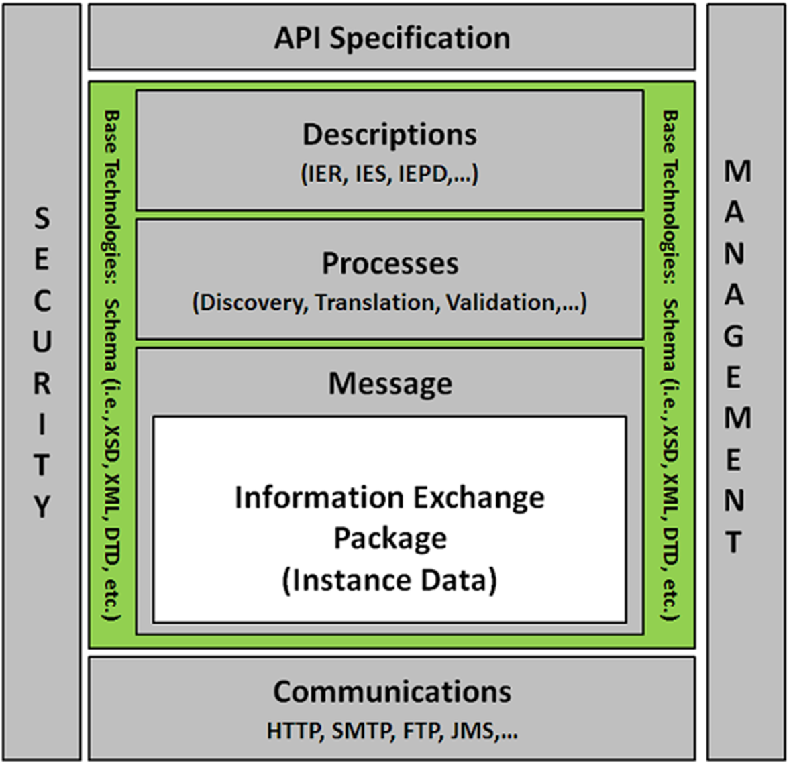
Scope of niem
NIEM is a data layer standard and intentionally does not address all the necessary technologies needed for information sharing
Exchange partners decide how to store and process the NIEM-conformant data being exchanged
Notes:
NIEM intentionally does not address standardizing data inside legacy systems. NIEM serves as a translation layer (providing a common understanding) between and across disparate systems
In order to provide infrastructure flexibility, NIEM does not define implementation specifications
NIEM defines the format and structure of data in transit
Exchange partners decide how to store and process the NIEM-conformant data being exchanged
NIEM can be established within an organization’s Service Oriented Architecture (SOA) as a data standard for all information exchanges
Security and privacy should be key considerations when implementing an exchange

Slide 55
Data Interoperability Problem
DATA
UNDERSTANDING
IF THESE AREN’T COMPATIBLE…
DATA
UNDERSTANDING
THIS WON’T WORK
DATA
EXCHANGE @ RUNTIME
SYSTEM / APPLICATION
SYSTEM / APPLICATION

Slide 56
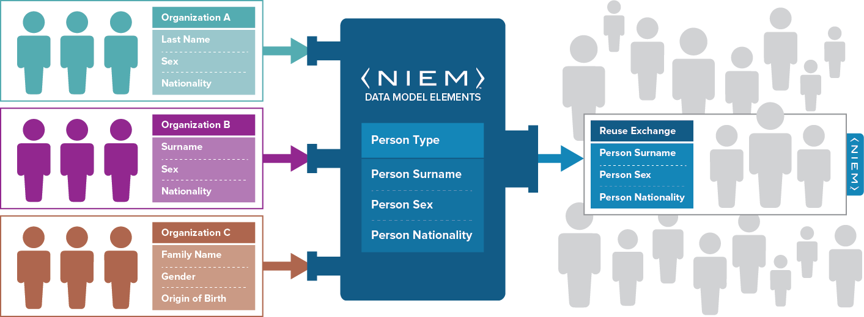
Niem in action: How NIEM Exchanges Data Components and Data Elements
NIEM is
a common vocabulary –
enabling efficient information exchange across diverse public and private organizations
NIEM is not a system or database – NIEM does not specify how to transmit or store data
Using NIEM, organizations come together to agree on a common vocabulary When additional organizations are added to the information exchange, the initial NIEM exchange can be reused, saving time and money

Slide 57
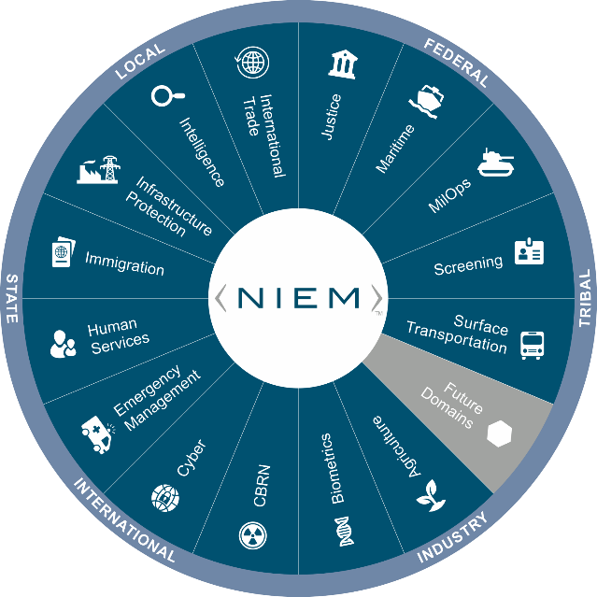
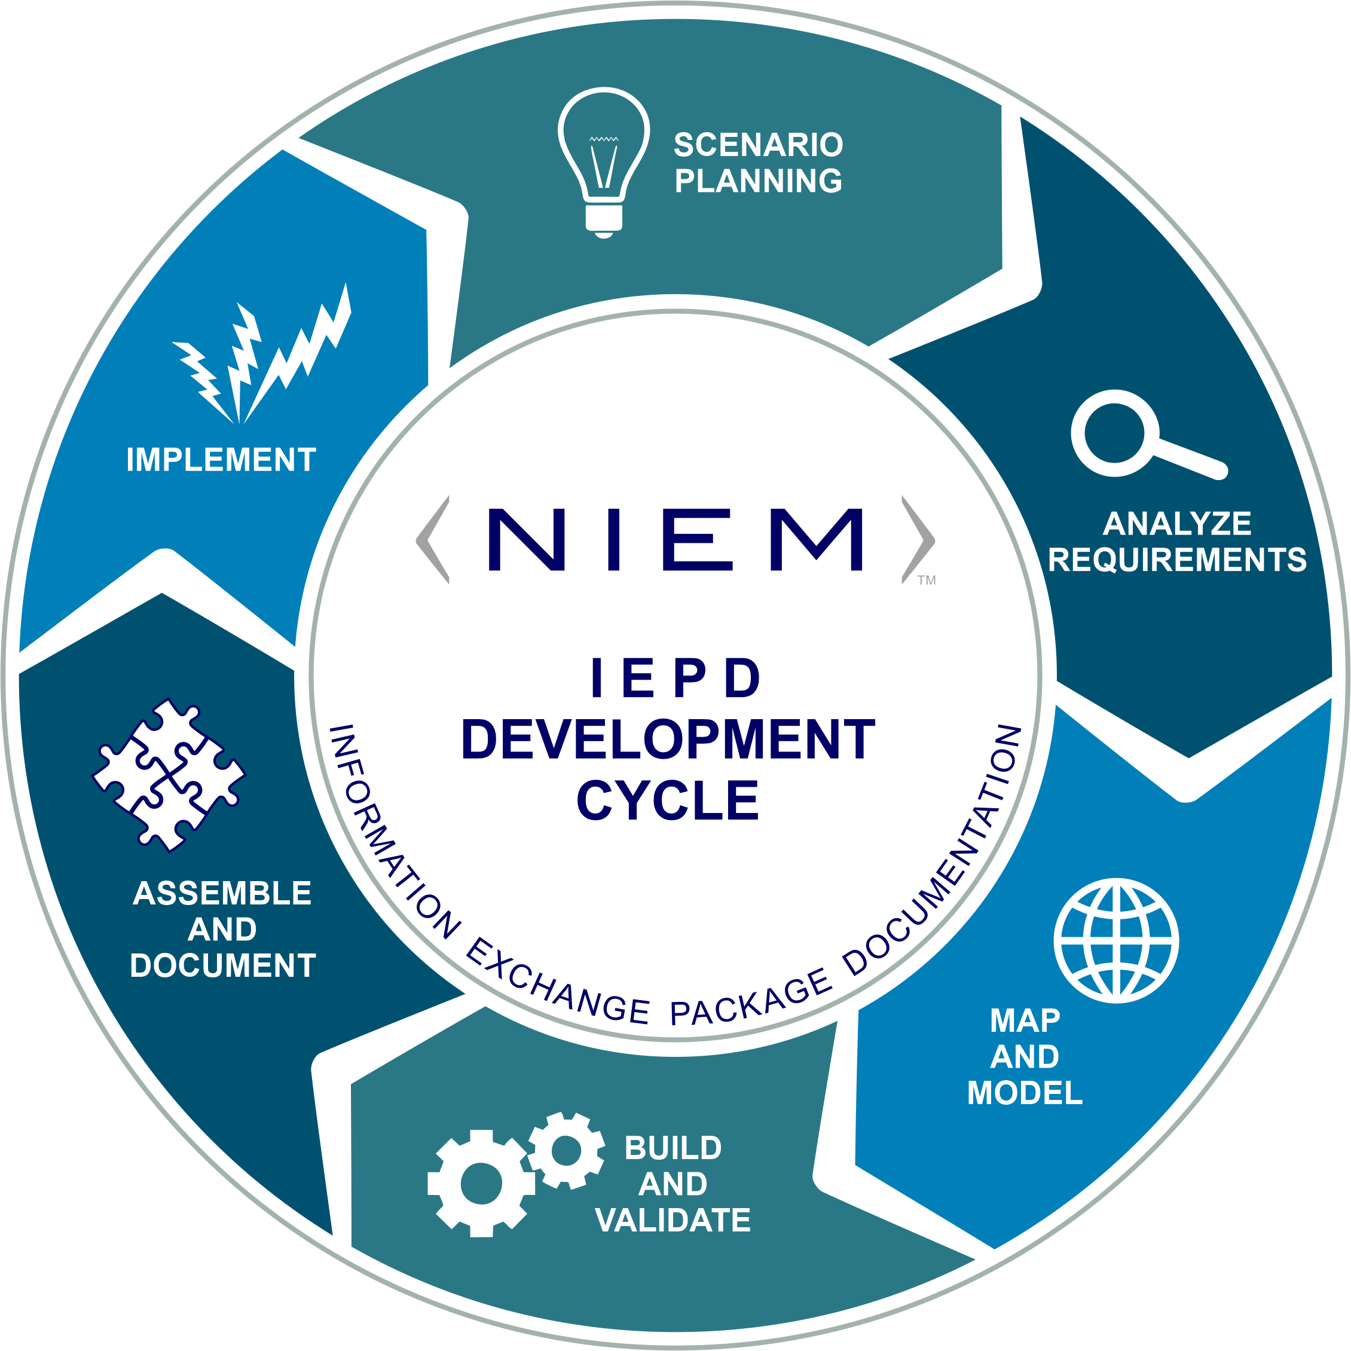
NIEM – The Big Picture
NIEM enables organizations to move information across organizational boundaries in order to interoperate − and act as one − while each maintains authority for their own existing systems
Common Language (Data Model Lifecycle)
Repeatable, Reusable Process
(Exchange Specification Lifecycle)
Built and governed by users within the Federal, State, Local, Tribal, and Private Sectors

Slide 58
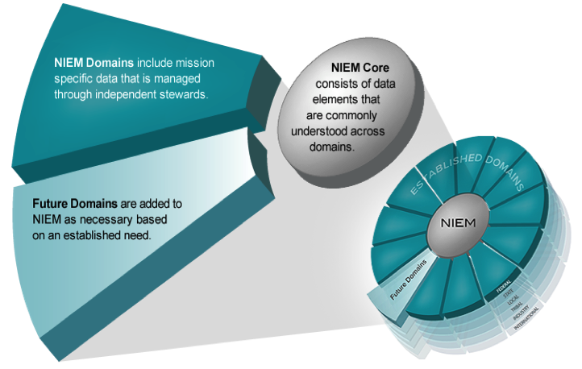
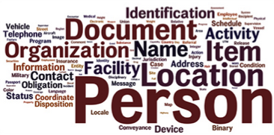
model overview
Think of the NIEM data model as a mature and stable data dictionary of agreed-upon terms, definitions, relationships and formats independent of how information is stored in individual agency systems
The data model consists of two sets of closely related vocabularies:
NIEM core
Individual NIEM domains
NIEM core includes data elements commonly agreed upon across all NIEM domains (i.e., person, activity, location, and item, etc.)
Individual NIEM domains contain mission-specific data components that build upon NIEM core concepts
58

Slide 59

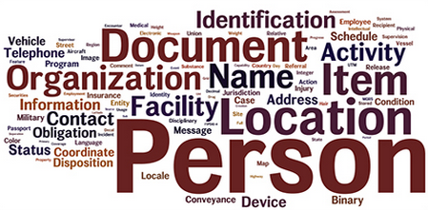
NIEM Model Content
Think of the NIEM data model as a mature and stable data dictionary of agreed-upon terms, definitions, and formats independent of how information is stored inside individual IT systems.
NIEM Domains
Agriculture
Biometrics
Chemical, Biological, Radiological, & Nuclear
Cyber
Emergency Management
Human Services
Immigration
Infrastructure Protection
Intelligence
International Trade
Justice
Maritime
Military Operations
Screening
Surface Transportation
59

Slide 60
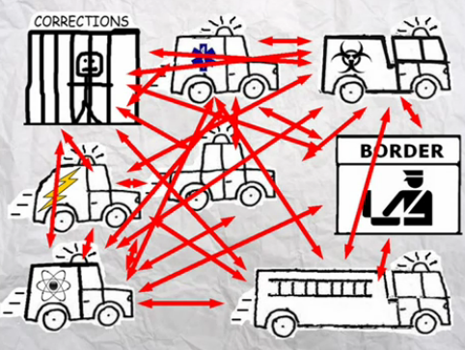
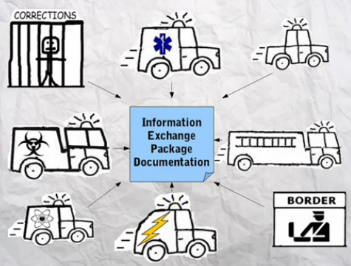
Niem ADVANTAGE
When using NIEM, you only need to “speak” two languages — your own and NIEM
EXAMPLE Communicating With 15 Different Systems
Without NIEM | Using NIEM
LOE Single Program Mapping = 14 LOE Total Mapping = 210 210 Total Interface Mappings | LOE Single Program Mapping = 1 LOE Total Mapping = 15 15 Total Interface Mappings
Level of Effort (LoE)
60

Slide 61
NIEM Community Stakeholders
The NIEM community continuously communicates with six different stakeholder types
Each stakeholder is interested in NIEM and how it can help their organization or project for different reasons
Executives
NIEM minimizes the time-to-market while allowing maximum flexibility.
Program Managers
NIEM can make a job easier by helping teams build exchanges in less time, for less money time.
Architects
NIEM offers a better way to exchange data and is adaptable; it can be modified or new capabilities added to an existing exchange.
Developers
Tools and support are available to make exchange development easier and faster.
Implementers
NIEM can lower the cost of maintenance in comparison to legacy formats.
Tool Providers
NIEM can be an avenue to connect with customers who have an interest in information sharing capabilities.
61

Slide 62
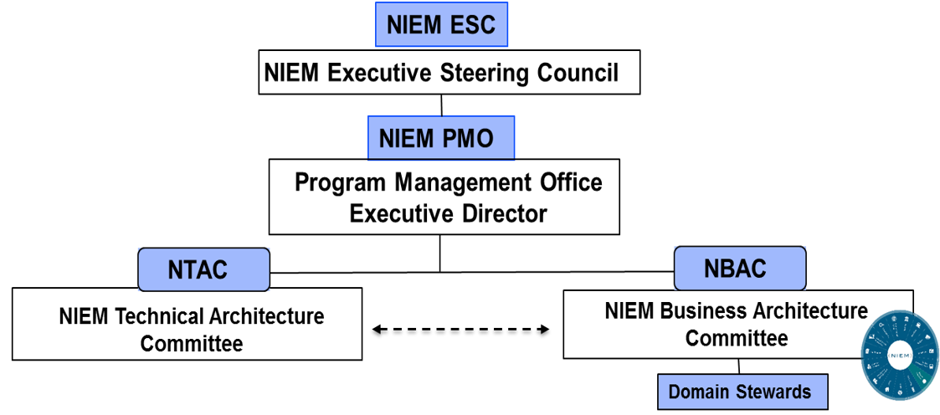
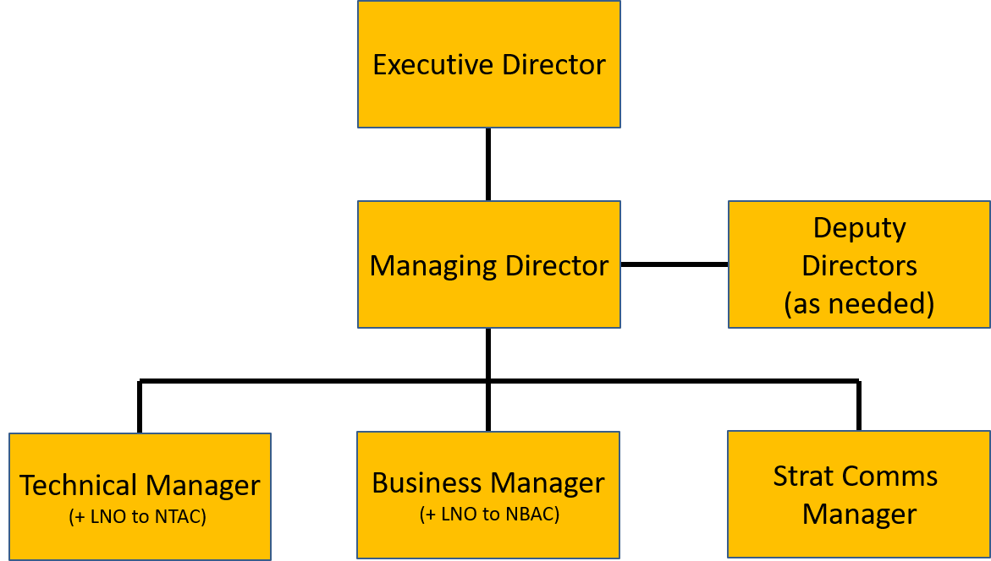
NIEM Organization Governance
NIEM provides standardized enterprise-level information exchange across Joint, Coalition and Interagency domains
Chaired by DOD CDO SES Mr. Spirk
Quarterly or every 6 months
DOD CIO
JS J6
Led by JS J6 SES Mr. Whitehead
Conducts day-to-day management
JS6 provides NTAC and NBAC LNO
Oversees face-to-face stakeholder sessions
Internal NIEM MO structure manned by JS6 personnel
2 co-chairs + 12 selected Subject Matter Experts from across Gov’t and industry
- Focuses on technical specifications
Implementing NBAC business requirements
2 co-chairs + 40 members in 14 functional domains from across Federal / State / Local / Tribal / Territorial Gov’t plus international
- Focuses on model content

Slide 63
NIEM is an Open Standard
The National Technology Transfer and Advancement Act
(NTTAA) directs Federal agencies to adopt voluntary consensus standards wherever possible (avoiding development of unique government standards) and establishes reporting requirements.
OMB A-119 Federal Participation in the Development and Use of Voluntary Consensus Standards and in Conformity Assessment Activities
All federal agencies must use voluntary consensus standards in lieu of government-unique standards in their procurement and regulatory activities, except where inconsistent with law or otherwise impractical.
NIEM Alignment to Open Standard Criteria
Openness
Balance of interest
Due process
Appeals process
Consensus

Slide 64
Standards that include NIEM
ANSI 42.42 Radiological Nuclear detectors – CBRN Domain
ANSI APCO Alarm Monitoring Company to Public Safety Answering Point (PSAP)
OASIS EXDL, Emergency Data Exchange Language FEMA (Emergency Management Domain)
NIST Big Data Framework Vol 7
Nation Fire Protection NFPA 950 calls for compliance with NIEM. Emergency Incident Data Document (EIDD) IEPD – NISTIR 8255
Biometrics ANSI/NIST ITL Standard – Biometrics Domain
Biometric Conformance Test Software (BioCTS)
BioCTS for AN-ITL v2 is a desktop application which tests electronic biometric data files, known as transactions, for conformance to NIST Special Publication (SP) 500-290
Conformance Test Architecture (CTA) and Test Suite (CTS) called "BioCTS for AN-2011 NIEM XML" designed to test implementations of AN-2011 NIEM XML encoded transactions.
NIEM cited in patent – Integrated Environment for Developing Information Exchanges patent No: US 8,769,480 B1 Dated July 1, 2014
Model Minimum Uniform Crash Criteria Guideline (MMUCC) – Department of Transportation

Slide 65
NIEM Domain Overview
NIEM Domain | Organizational Sponsor | Content Focus | Points of Contact
Agriculture | Department of Agriculture | Farm Service Agency (FSA) and Risk Management Agency (RMA) reporting data about crops, acreage, and revenue as part of the federal crop insurance program | Garon Reeves
Biometrics | DHS National Protection and Programs Directorate Office of Biometric Identity Management | Part of a coordinated global effort to maintain and refine operations focused on security, intelligence, law enforcement, international trade, travel and immigration by means of identity management and assurance | John Boyd (SES) Thomas Freed
Chemical, Biological, Radiological, and Nuclear | DHS Domestic Nuclear Detection Office (DNDO) with cooperation of Customs and Border Patrol | National effort to detect and interdict radiological and nuclear threats. The GNDA (Global Nuclear Detection Architecture) involves DHS, DOJ, DOE, DOS, DOD, the Governmental Nuclear Regulatory Commission (NRC), state, local, and tribal agencies | Lon Gowen Dr. Brendon Plapp
Core | DHS/DOD | Common data types, properties, code sets across multiple Domains | Christina Medlin Ralph O'Connell
Cyber | DHS Cybersecurity and Infrastructure Security Agency | Enable Federal Government and critical infrastructure owner and operator's information exchanges | Preston Werntz Juan Gonzales
Emergency Management | DHS Science and Technology First Responders Group | Supports emergency-related services (first responders, responding to disasters), information sharing, and activities such as homeland security and resource communications management | Dan Cotter (SES) Kamran Atri
Human Services | Department of Health and Human Services (HHS) Administration for Children and Families | Create and encourage greater collaboration and service integration among human service programs and agencies to improve client outcomes, lower costs, and enhance operational efficiencies | Dorothy Wan
Immigration | DHS Citizenship and Immigration Services (CIS) and Immigration and Customs Enforcement (ICE) | Standardized information sharing to improve investigative and enforcement responsibilities for federal immigration laws, customs laws, and air security laws to foster better collaboration with their external partners | Jennifer Kish Curtis Ross

Slide 66
NIEM Domain Overview (cont’d)
NIEM Domain | Organizational Sponsor | Content Focus | Points of Contact
Infrastructure Protection | DHS Office of Infrastructure Protection ​ | Coordinated national program to reduce risks to the nation's critical infrastructure and key resources (CIKR) | Preston Werntz
Intelligence | ODNI Criminal Intelligence Coordinating Council and the federal Intelligence Community | Identify the operational needs to exchange intelligence, as well as the opportunities to share information with other domains and functions in justice and homeland security | Sue Dohr
International Trade | DHS Customs and Border Protection | Enable resulting in greater facilitation of trade and more effective identification and elimination of security threats before they arrive at ports and borders. Aligns with the World Customs Organization (WCO) Data Model and the Customs Business Process models. | Tomas Mills
Justice | FBI steward the U.S. Attorney General's Advisory Council on Global Justice Information Sharing | Global Justice XML Data Model​ (GJXDM) became the first NIEM domain in 2005 to enable the entire justice and public safety communities to effectively share information at all levels – laying the foundation for local, state, tribal, and national justice interoperability. | April Mitchell Cherie Cochran
Maritime | Office of Naval Intelligence OCIO stewards in coordination with DHS | Support full Maritime Domain Awareness: "the effective understanding of anything associated with the global maritime domain that could impact the United States’ security, safety, economy, or environment" including vessels, people, cargo, maritime locations and activities | Ms. Sandra Brown Ms. Kelly McCool Harry Petrey
Military Operations | Joint Staff J6 stewards on behalf of the DOD CIO | Data components necessary to support improved data interoperability between DOD and mission partners for operations | Ralph O’Connell Adrian Francis
Screening | DHS | Supports, coordinates, and harmonizes a wide range of screening and credentialing activity information across homeland security mission areas | Steve Yonkers
Surface Transportation | Department of Transportation CDO | Exchange transportation information between organizations to support DOT Traffic Records Coordinating Committee and the State Traffic Records Coordinating Committees | Daniel Morgan (SES)

Slide 67

Value Proposition – Interoperability
The interoperable nature of NIEM establishes:
Common Language and Vocabulary
Agnostic Implementation
NIEM eliminates confusion by providing consistency of data definitions between agencies
NIEM is open-nonproprietary, scalable, tailorable. Platform, language, system, and network agnostic
NIEM enables systems to work together at the data level
Implementers decide how agencies’ systems are implemented
Notes:
NIEM enables systems to work together at the data level, Implementers decide how agencies’ systems are implemented

Slide 68

Value Proposition – Reusability
The reuse of IEPDs, in part and whole, within NIEM will:
Decrease Development Time
Increase Consistency
Decreases the development time for information exchanges that use similar sets of data
Allows practitioners to increase the syntactic and semantic consistency in data definitions across their information exchanges

Slide 69

Value Proposition – Standardization
The formalization of NIEM as a standard enables
Large Support Community
Structured Approach
NIEM Practitioners can leverage NIEM’s large support community to decrease development time for exchanges and increase conformance
Repeatable approach that decreases the inconsistencies and duration of development

Slide 70
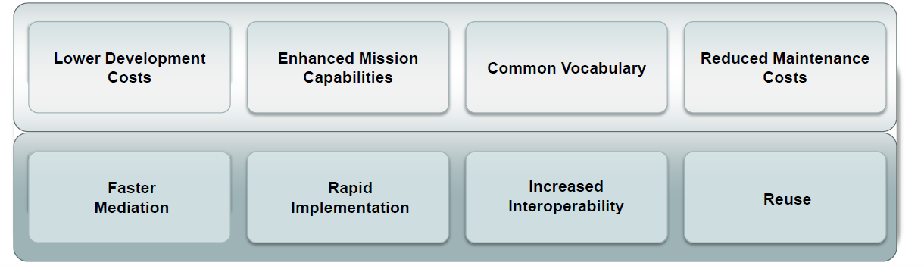
Why NIEM?
Collaboration
NIEM brings stakeholders together through reuse and community engagement
Consistency
NIEM provides consistency through reusable schema, which allows for many implementation options
Development
Flexible and extendable, NIEM saves development time through agreed-upon elements, relationships, and formats independent of how information is stored in individual systems
Support
New users can leverage what already exists and engage directly with other NIEM members for assistance.
WHICH LEADS TO

Slide 71
SOME Information exchanges built on NIEM
Amber Alert - child abduction emergency alert.
Centers for Disease Control and Prevention (CDC) Emergency Preparedness and Response Exchange Requirements - exchange and sharing of critical emergency management (EM) data.
CrimTrac – Australian national information-sharing services between state, territory and federal law enforcement agencies. Inter-Governmental agreement between the Commonwealth and each of Australia’s nine police agencies.
Defense Counterintelligence and Security Agency (DCSA) - Insider Threat data, the DD-254 IEPD (security clearance application information), and the National Industrial Security System (NISS)-Defense Information Security System (DISS) IEPD.
FBI Incident Reporting National Data Exchange System (N-Dex) standardized and secure criminal justice information sharing to relevant criminal justice agencies.
FBI National Crime Information Center (NCIC) - United States' central database for tracking crime-related information.
FBI National Incident Based Reporting System (NIBRS) - nationwide reporting system for incident and arrest data from local, state, tribal, and federal law enforcement agencies used to generate accurate national crime statistics.
FBI Use of Force - data collection program to provide nationwide statistics on law enforcement use-of-force incidents.
Florida Incident Based Reporting System (FIBRS) – Florida arrest affidavit, criminal justice data transparency, computerized criminal history, electronic warrants & protection orders, etc.
Partner Engagement Information Sharing Environment (PE-ISE) – led by US DNI, PE-ISE leverages information sharing capabilities to focus on terrorism-related information sharing, homeland security, and counter proliferation of weapons of mass destruction missions.
International Justice and Public Safety Network (NLETS) - exchange mission-critical law enforcement information between the United States and INTERPOL databases.
Prescription Drug Monitoring Exchange (PMIX) - Mitigate pharmaceutical drug abuse across state lines.
Notes:
DISS replaced the Joint Personnel Adjudication System (JPAS) as the System of Record on March 31, 2021.

Slide 72
Skill level to Implement NIEM
Developers with the skills to design and implement a data exchange can learn the NIEM approach in a matter of hours
Developer training is available
No-cost online courses are on the NIEM website
Plenty of example IEPDs to follow
Don’t start from scratch, leverage shared IEPDs
The NIEM technical specifications are complex, however
Most developers do not need to read them
Free tools can perform most of the conformance checking

Slide 73
training
Start your action plan and schedule your resources for NIEM training!
Existing Training
Domain Modeler: A domain modeler creates and manages the content in a NIEM domain.
IEPD Developer: An Information Exchange Package Documentation (IEPD) Developer designs, builds, and validates the components (artifacts) of an Information Exchange Package (IEP).
IEPD Implementer: An IEPD implementer exchanges information based on the format, rules, and guidance provided by an existing IEPD specification.
Upcoming Training
Revamped Implementer: Reorganized to focus on the development process. Dry run last week in September.

Slide 74
Final thoughts
Leverage the NIEM Management Office as a resource
Technical implementation support
Development Tools
Training resources online and instructor led
Implement NIEM to share information across multiple Military Defense Intelligence Agencies data systems: Defense Counterintelligence Security Agency (DCSA), Naval Criminal Investigative Service (NCIS), Army Criminal Investigation Command (CIDC), Air Force Office Special Investigations (OSI), Defense Intelligence Agency (DIA) and the Navy Inspector General (IG)

